Slide 1

The Galena Territory Informational Town Hall Meeting

Slide 2
Agenda
Welcome & Introductions
Nicor Gas Overview
Extending Natural Gas to The Galena Territory
Neighborhood Expansion Program (NEP)
Project Timeline / Next Steps
Q&A

Slide 3
Nicor Gas Overview

Slide 4
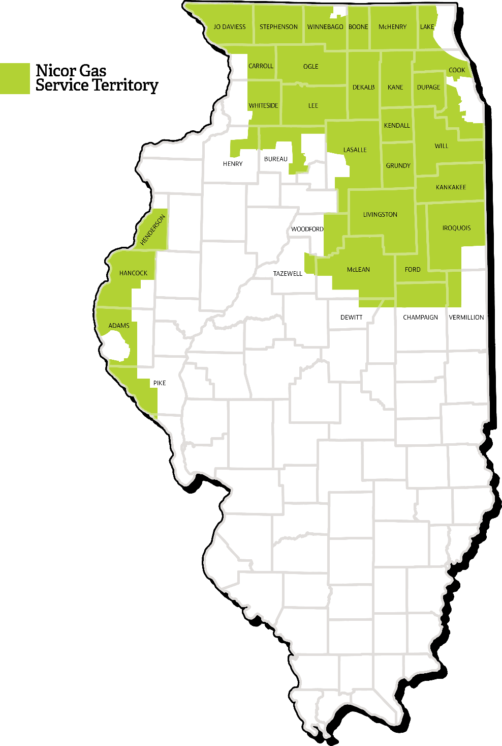
Nicor Gas Overview
Nicor Gas is the largest natural gas distribution company in Illinois
2.2 million customers
656 communities
17,000 square miles of territory
34,000 miles of main
43 regional offices across the state
4.6 billion annual therms
Rockford
Naperville
Chicago
Joliet
Peoria
Bloomington
Springfield
Interstate Pipeline Transporters
Nicor Gas Service Territory
Major Gas Main
Underground Gas Storage Field
Major Cities
Natural Gas Pipeline Company of America
Northern Natural Gas Company
ANR Pipeline

Slide 5


Our Product

Slide 6

Benefits of Natural Gas
Natural gas is…
Safe & Reliable
Nicor Gas operates a robust, reliable, safe system
Nicor Gas maintains the infrastructure
Affordable & Abundant
There is a large supply of natural gas in North America, which keeps commodity costs low, with no dramatic price fluctuations
Convenient
There are no deliveries to schedule and no annual contracts for service
Nicor Gas offers convenient billing and payment options

Slide 7
Extending Natural Gas to The Galena Territory

Slide 8

What is the Neighborhood Expansion Program (NEP)?
In 2017, the Illinois Commerce Commission approved Rider 33 – Designated Extension Service Area (DESA), which we refer to as the Neighborhood Expansion Program (NEP).
The Neighborhood Expansion Program (NEP) spreads the financial contribution required to bring natural gas to an area among all residents. Each customer pays an equal portion of the required contribution when they attach to the natural gas system.
The program provides a tariff mechanism that allows residential customers to pay the required contribution over time, rather than a single upfront payment
Customers can convert at their convenience – no payments are due until you choose to have natural gas service

Slide 9
Costs to Convert
3 costs to consider during a conversion project:
Connection Charge
+
Over Distance Charges
+
Home Conversion Costs

Slide 10
NEP – Connection Charge
What is the connection charge for The Galena Territory?
The connection charge is $4,518.23 per service request
There are 2 ways to pay for the connection charge: *
Pay the full amount upfront, in advance
Choose the Customer Payment Option (CPO)
10-year payment plan, billed on your monthly natural gas bill (116 equal, monthly installments - $60/month)
The monthly payment amount includes a carrying cost set at the company’s authorized rate of return as approved by the ICC at the time the NEP is established. The current carrying cost is 7.26%.
*Commercial customers are not eligible for the Customer Payment Option (CPO).

Slide 11
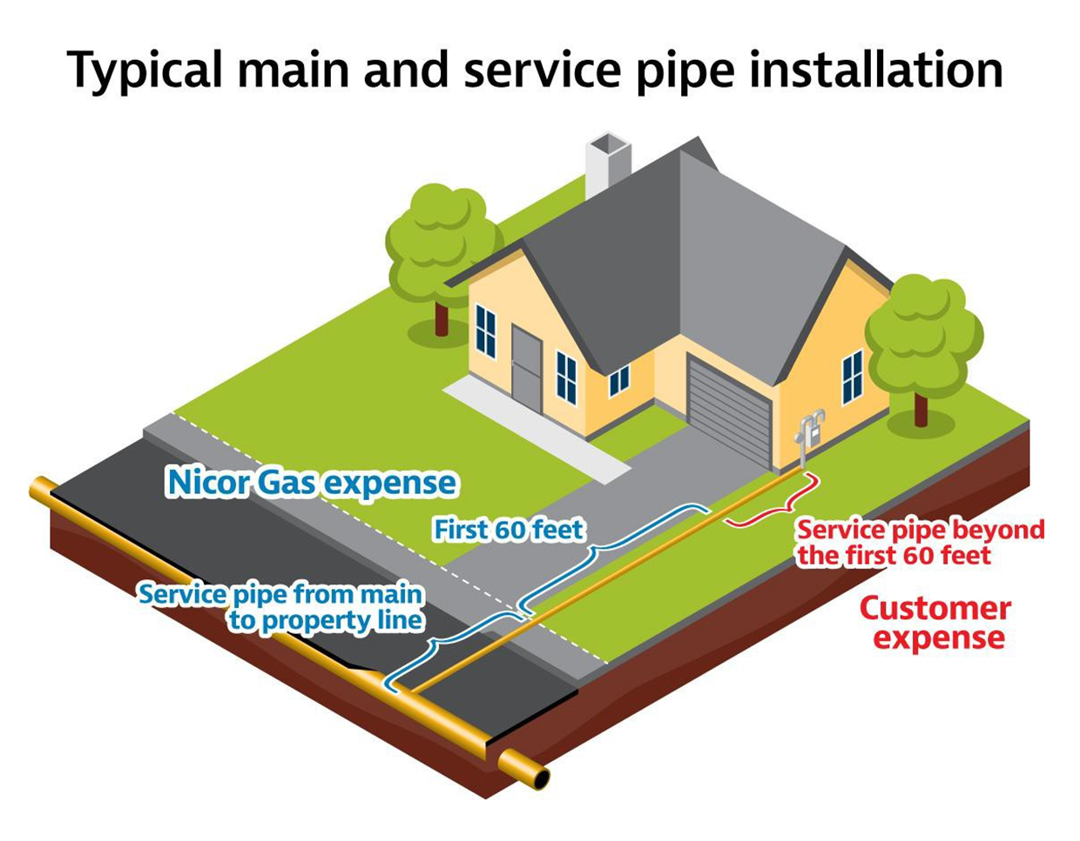
Over Distance Charges
Over Distance Charges*
The first 60 feet of service line is free to the customer
Services lines greater than 60 feet will incur over distance fees
*Over distance charges are only applicable for customers who require a service line >60’

Slide 12
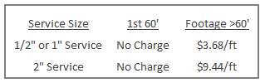
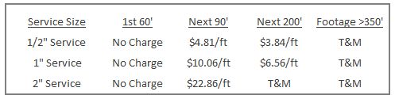
Over Distance Charges
During project construction, there will be reduced rates for over distance fees. These rates are specific to the residential properties in The Galena Territory.
These costs are based on normal construction conditions. If unusual conditions exist, there may be additional costs incurred. Unusual conditions may include, but are not limited to, rock bore required, water/creek crossing, unusual depths, etc.
Customers are responsible for marking any private underground infrastructure that are not part of the J.U.L.I.E system (buried propane tanks, septic systems, sprinkler systems, etc.)
Once construction is completed, over distance fees will be the approved cost per foot at that time, as per our Terms & Conditions. Current over distance rates @ 7/2019:

Slide 13

Home Conversion Costs
Nicor Gas will install, own and maintain the natural gas service pipe and meter outside of the home. The Customer is responsible for the installation and maintenance of any gas piping beyond the outlet of the meter to reach the home’s appliances.
We recommend using a qualified heating or plumbing professional to perform this type of work and to understand applicable costs.
Once you are a customer, you may qualify for rebates and incentives through the Nicor Gas Energy Efficiency Program for certain energy efficient products, appliances and improvements.

Slide 14
Project Construction Timeline & Next Steps

Slide 15
Project Construction Timeline
Project Construction
The entire project will require Installation of approximately 80 miles of natural gas main to serve The Galena Territories
4 Phases of installation*:
Phase 1 – estimated start September 2019
Phase 2 – estimated start ~ Winter 2019
Phase 3 – estimated start ~ Early Spring 2020
Phase 4 – estimated start ~ Early Summer 2020
Each phase will take approximately 4 – 6 months to complete construction
Crews will install individual services as natural gas becomes available
*Construction schedules are estimated and will be heavily dependent on weather and land conditions

Slide 16
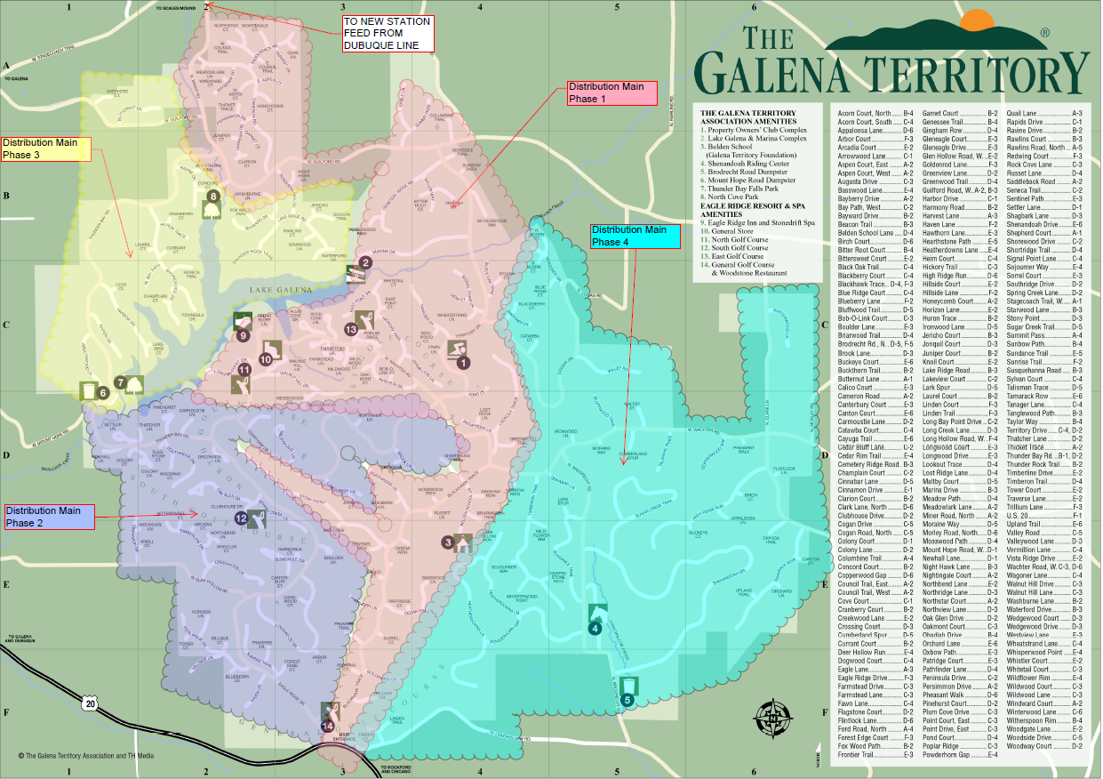
Project Construction Timeline
Project construction schedule broken down into 4 major phases
Project estimated to be completed in 18-24 months
Construction schedule is dependent on weather and land conditions
Services will be installed shortly behind gas main installation as pipe is “livened” up (gas flowing)

Slide 17
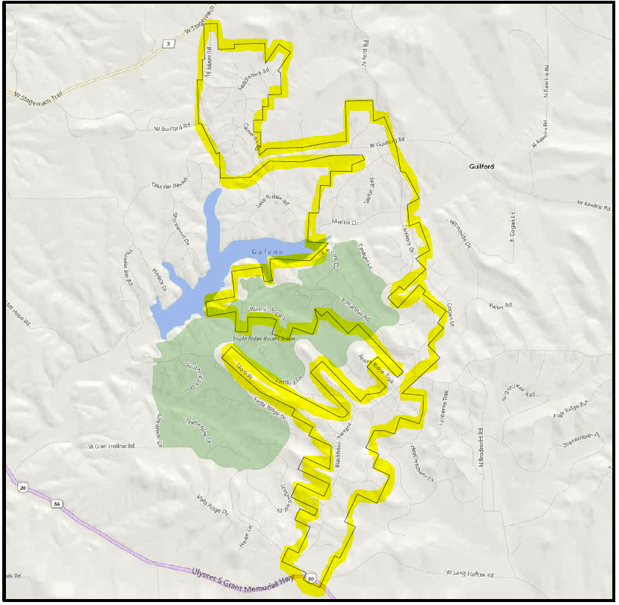
Project Construction Timeline – Phase 1
Phase 1:
Construction estimated to begin September 2019
Properties in Phase 1 who are interested in natural gas service should submit an application or meet with a Nicor Gas representative for additional information as soon as possible
We will meet with customers and accept applications regardless of what phase your property is in

Slide 18
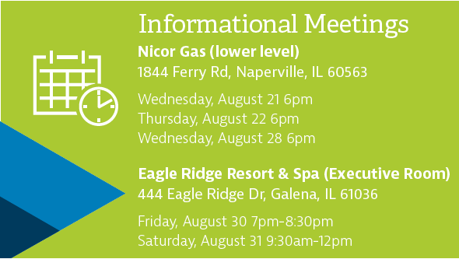
Next Steps
Several informational meetings in August and more upcoming dates for September
Contact a Nicor Gas representative for more information about natural gas service
Sign up for natural gas service online or schedule an appointment with a representative
Upcoming Meetings

Slide 19
Q & A

Slide 20

Thank you for your interest in clean, safe, reliable, and affordable natural gas!

